Slide 1




Workplace Wellness Micro Grant
Lunch and Learn Kick-Off
March 3, 2022
Notes:
Introductions:
Yao

Slide 2
Agenda
SPAC Overview
SHIP Overview
Micro Grants Menu
Wellness Program Start Up
Mindful Moment
Timeline & Expectations
Q&A
Notes:
Yao

Slide 3
St. Paul Area Chamber
150+ year old organization supporting for-profit, non-profit and government members – we are the voice of the “employer community”
501c (6)
Four Advocacy Priority areas - Workplace Wellness is part of our “Livability” focus
Notes:
Yao- SPACC Overview

Slide 4
What is Workplace Wellness Micro Grant?
A partnership with St. Paul Area Chamber, Saint Paul – Ramsey County Public Health, and State Health Improvement Partnership.
Money to support workplace wellness initiatives. It’s that simple.
Notes:
Yao- SPACC Overview

Slide 5
SHIP Overview
Statewide Health Improvement Partnership (SHIP) grant
Minnesota Department of Health grant that local public health departments determine how to use
Focus on healthy eating, active living,
tobacco-free living
Notes:
Lia Yang, Saint Paul - Ramsey County Public Health
Statewide Health Improvement Partnership (SHIP) Overview
To give a brief overview about SHIP, SHIP stands for Statewide Health Improvement Partnership. This is a grant that is given from the Minnesota Department of Health to local public health departments to utilize. This grant mainly focuses on health eating, active living, and tobacco-free living.

Slide 6
SHIP Overview
Focus on policy, system and environmental (PSE) changes
  Organizations can make PSE changes to establish a healthier workplace for employees
Example 1: have a healthy food policy where only health refreshments are encouraged at office meetings
Example 2: creating a system where employees can checkout and use exercise items (resistance band, weights, etc.) during breaks
Notes:
Lia Yang, Saint Paul - Ramsey County Public Health
Statewide Health Improvement Partnership (SHIP) Overview
SHIP also focuses on . . . *Read the slide*
I just want to put an emphasis on really focusing on these changes within PSE because it really determines what if these changes being applied is something for the long-term or is it only staying for a short-term period of time. And the question being asked is, “Is the changes we are making sustainable?”

Slide 7
Grant Overview
Examples of allowable expenses
  Equipment that supports wellness
    Arm chair, appliances, cutting board, gardening tools, bike rack, portable physical activity equipment, bike accessories
Examples of unallowable expenses
  Consumable items
    Labor, contract, food, therapy, rent, leasing, water filters, etc.
  Other examples:
    Electronic pedometers (e.g. Fitbits), bikes, magazine & newspaper subscriptions, gym memberships, iPad/tablets, smartboards, Service Plans, vending machines, massage chairs, and etc.
Ask yourself: can the equipment/supplies be used by multiple people and multiple times? If it is only for one person or one-time use, it likely doesn’t qualify.
Unsure? Please contact Yao at wellness@saintpaulchamber.com or 651-265-2780
Notes:
Lia Yang, Saint Paul - Ramsey County Public Health
Statewide Health Improvement Partnership (SHIP) Overview
Within this grant, there are some guidelines that needs to be followed about allowable and unallowable expenses. Here are some examples of what the expenses can and cannot be used for, but the main thing that should be ask is can the equipment/supplies be used by multiple people and multiple times? If it is only for one person or one-time use, it likely doesn’t qualify. For example one of the many things that would not be qualified is buying food for a meeting, which is a one time transaction, one time use. Versus maybe having a garden where you can grow produce for many years and be able to utilize that over and over again.
If there are expenses that you may be unsure about withing your micro grant project, you can contact Yao who can be able to help you determine if its qualified or not.

Slide 8
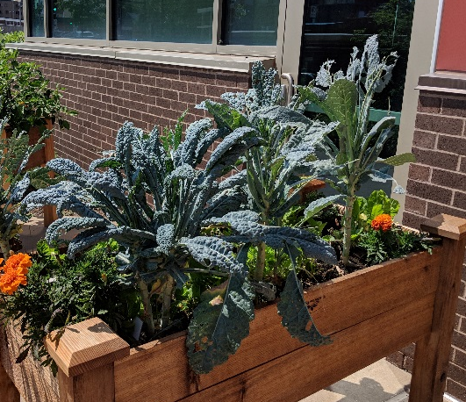
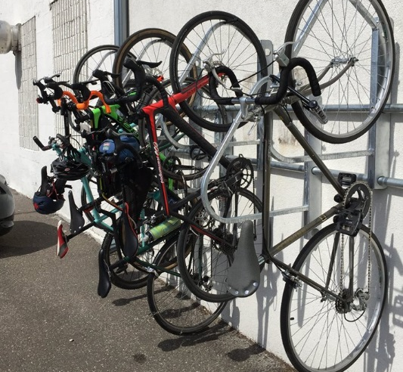
Micro Grant Projects
Healthy Eating
    $600 Break Room Change-Up!
    $600 Giving Garden
Tobacco Free Living
    $250 No Smoking Signage
Breastfeeding Support
    $800 Supporting Nursing Mothers
    $300 Wellness Room (supplemental)
Physical Activity
    $500 Physical Activity Station
    $900 Commuting Help
Well-Being Supplement
    $500
    Must be awarded one of the initiatives above to qualify
Notes:
Lia Yang, Saint Paul - Ramsey County Public Health
Pre-Survey link: https://www.surveymonkey.com/r/JP9GS8S
Here are the list of Micro Grant Projects that all of you have looked over and decided to partake in at least one of these projects. So this should look a little familiar. I believe examples of each project or initiative was also given to explore the idea of what you can do with the micro grants that you received for your project.
I just also want to give a reminder that within the Workplace Wellness Micro Grant, you all should have received a link to a pre-survey that was sent by Yao. It required that as a grantee, all of you complete this so we can continue to collect data as SHIP staff to be able to continue the work that we doing, like being able to have this Workplace Wellness Micro Grant. That will be dropped in the chat, it’s a very easy survey of 8 questions to get the scope of your organization and what you may possibly need from us.
There is a wide range of initiatives that could be done, and one of the newest one that was recently added in was the Well-Being Supplement which you had to had applied for during your application for the Workplace Wellness Micro Grant and also get approved of another initiative listed here in order to get the Well-Being Supplement.

Slide 9
Well-Being Supplement
Still undergoing communication with the Minnesota Health Department
Questions and concerns, please contact Lia at lia.yang@co.ramsey.mn.us or 651-279-2985
Notes:
Lia Yang, Saint Paul - Ramsey County Public Health
With the Well-Being Supplement being one of the newer projects added in, Yao has been communicating with some of you to get more details about your Well-Being projects. Please be patient about the next steps of what this might entail from me and Pa, as SHIP staffs, are still communicating with the Minnesota Department of Health to make sure that ideas of utilizing this Well-Being supplement follows the SHIP grant guidelines.
If there are questions or concerns about this, it might be best to contact me about it.

Slide 10
Wellness Program Startup and Sustainability
Foundation
Leader Support
Vision Statement
Brand
Communication
Wellness team
Goals
Notes:
Pa Shasky, Saint Paul - Ramsey County Public Health
Before I get started can I just get a feel for the room? How many of you currently have a wellness program in place? How many have had a program for at least one year? Three, five, longer?
How many of you who have had a program for quite a while are happy with the engagement of your employees into your program?
Today, we are going to talk about the foundational pieces to workplace wellness. We focus a considerable amount of time on the foundational pieces because they are the foundation of your wellness program and help create some stickiness the program.
Here are the foundational elements. Notice this isn’t a sequential process. Things can change in an organization that affect the wellness program. The leadership may change, employees who sat on the wellness committee may leave the organization, the demographic make up of an organization can change.
Leadership support is a vital role in any employee wellness initiative. Without it, programs exist but can flounder.
Wellness team: developing a team that includes a broad cross section of employees creates the infrastructure that has representation across the organization; increasing buy-in and helps to avoid some of the potential road blocks.
Measurement or evaluation: like any process, measurement gives you data that can help to tell the story of your efforts and goals, help identify what it is you want to measure, not to mention help with accountability. This is a piece forgotten by a lot of wellness coordinators or wellness committees, but it is necessary to be able to report to leadership what is going well and what is not when it comes to your wellness initiative.
Vision Statement: A statement of the organization’s values and goals for their wellness initiative. Can help focus strategic planning direction.
Brand: It’s what your initiative is. Think of it as your initiative’s purpose, principles and passion. A logo is not a brand – a logo evokes the image of what you want your audience to think of when they think of your wellness initiative.
Communications: Having a solid communication plan is critical to effective initiatives.

Slide 11
Leaders Supporting Wellness
A visible champion
Regular Communication
Supportive Leaders
Provide decision
making power
Foster middle management support
Notes:
Pa
There are a variety of ways leaders can support a wellness initiative. These are just a few ideas.
Some leaders are very comfortable being a visible champion, while others are not. Being a good wellness role model is important so when leaders ask what you want them to do, make sure to include just doing things like getting away from their desk to not talking openly about their less than healthy behaviors.
We tend to think about senior level leaders when it comes to wellness program support, but it is important to include mid level managers as well. Good wellness initiatives can have senior level support but then be stopped by unsupportive middle managers.

Slide 12


Mission, Branding, Communication
Mission
Statement
Story
Principals
Branding
Identity
Connection
Communication
Awareness
Many modes
Notes:
Pa
How are you going to let employees know about your wellness program? What is it called, what does it look like, how will you let them know about it?
It is a good idea to create a mission statement for your wellness program that ties in to the mission statement of your organization. Do you know the mission statement of your organization?
A mission statement that coincides with the mission statement of the overall organization can show employees the organization is committed to the wellness program and the efforts to help employees live healthier lives while at work.
A brand logo can help employees identify what the wellness program is doing and gives it a visible presence throughout the organization.

Slide 13

Wellness Committee
Small Business 5-7 members
Large Business
8-14 members
Notes:
Pa

Slide 14

Mindful Moment
Notes:
Lia- change picture and title if needed.
Activity: Mindful Breathing - https://youtu.be/c1Ndym-IsQg
Backup Activity: Mindful Breathing Script

Slide 15

Evaluation
CDC ScoreCard
Notes:
Lia
Evaluation is also an important part of a workplace wellness program. Evaluating the organization as a whole as well as surveying the employees can help guide the wellness committee in creating a plan.
We recommend using the CDC scorecard to evaluate the organization.

Slide 16
CDC Scorecard
Shows areas of opportunity
Guides the wellness team
Shows progress
over time
Used to show leadership the state of the organization
Notes:
Lia

Slide 17
CDC Scorecard
Log on to http://www.cdc.gov/healthscorecard
Select the “New User” button
Answer “Yes” to register a new employer
When listing your employer name add SHIP at the end. For example, “ABC Company SHIP”
Complete the employer profile
Add your worksite
Select the “Register a New Worksite” button to add your worksite to your account from the employer dashboard (You must do this step before you are able to fill out the scorecard)
Select the “Get Started” button
Select “No I do not have an employer ID” button and press “continue”
Add your local public health representative as an account administrator
Add an employer administrator(s) from your workplace
After you register select the “Register Employer” button. A pop up window will confirm the account has been set up. The account log in will be displayed on this window and an auto generated e-mail will be sent to the account administrators with your log in credentials.
Select the “Worksite Health ScoreCard” link in the black box
Notes:
Lia

Slide 18
CDC ScoreCard
  This is optional, but highly encouraged
  Receive an additional $50 for your project if completed before October 6th
  SHIP Staff available to meet 1-on-1
  Time commitment varies from 30 min to 4 hours
  Recommend someone from HR or operations to fill out assessment
  Recommend having access to Employee Handbook accessible
Notes:
Lia
After reading slide content, ask if anyone on the call has completed the CDC ScoreCard before and what was their experience with it.

Slide 19
Policy and Guidelines
Writing policies does not have to be scary!
Guidelines are non-binding
Written policies/guidelines are important:
    For sustainability (the way we do things)
    For accountability
    To communicate practices (inform current employees)
    Reassess practices and policies to see progress and encourage continuous quality improvement
Notes:
Lia- importance of policies and guidelines
You can find sample policy language on the SPAC Wellness Page: https://www.stpaulchamber.com/workplacewellness.html

Slide 20
Timeline & Expectations
Notes:
Yao- timeline and expectation

Slide 21
Timeline & Expectations
Wellness Committee
Can your workplace commit?
Submit your workplace w-9 and MOU | 0.25 – 1.0 hrs
Meet and plan with your team (time varies for each workplaces and projects) | 2.0 – 8.0 hrs
Schedule and complete a check in call from March to May. | 0.5 – 0.75 hrs
Complete pre and post surveys | 0.5 – 1.0 hrs
Attend all 3 Workplace Wellness events: March 3 Lunch & Learn, June 16 Patio & Learn, and Oct 6 Lunch & Learn. Up to two staff may attend each event. | 6.0 – 8.0 hrs
Completing your project: researching, ordering/shopping, labor time, prepping, and etc. (time varies for each workplace and projects) | 6.0 – 12.0 hrs
Schedule and complete a site visit from June to October | 0.5 – 1.0 hrs
Updating your policy in your Employee Handbook to support your project. This includes waiting for approval from board or upper management. | 2.0 – 8.0 hrs
Estimated time commitment range | 17.75 – 39.75 hrs
Notes:
Yao- Timeline and expectations

Slide 22
FAQ
Do I have to send a report once I complete my project?
  No, there is no report for you to complete just surveys.
What if I can not make it to one of the events?
  Please arrange for someone from your workplace to attend. It is required to attend. Absence may result in losing experience and chances to successfully complete the grant.
What if I leave my workplace in the middle of the year?
  We required each workplace to have a second point of contact and they can pick up where you left off.
What do I do if there are still money left after spending on the project?
  Please let us know and we can advise what expenses are allowable.
Do I have to turn in receipts?
  No. You are not expected to turn in receipts
I need help creating my policies, are there examples?
  Yes! We have plenty of examples available on our website stpaulchamber.com/workplacewellness.html
Notes:
Yao- Timeline and expectations

Slide 23
Thank you!
Online information:
  https://www.stpaulchamber.com/workplacewellness.html
Email yao@stpaulchamber.com
  Call Yao at 651-265-2780
Email lia.yang@co.ramsey.mn.us
  Call Lia at 651-279-2985

